Slide 2


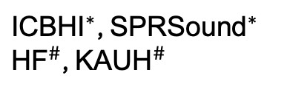
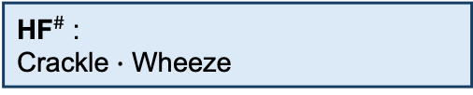

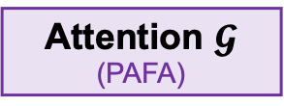
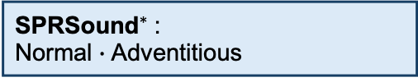
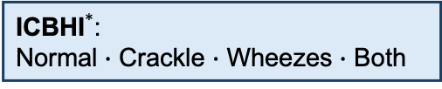

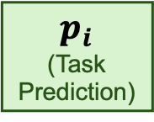

Linear Heads
Task-Specific Outputs
Respiratory Audio
A: Abnormal
${\text{ICBHI}}^{∗}$:
Normal $∙$ Crackle $∙$ Wheeze $∙$ Both
BEATs
Encoder
(Pretrained)
$$H_{i}$$
Mean Pooling
(Linear 768→256)
$$T_{i}×D$$
$$p_{i}$$
(Shared Attributes)
C: Crackle
${\text{SPRSound}}^{∗}$:
Normal $∙$ Adventitious
${\text{ICBHI}}^{∗}$, ${\text{SPRSound}}^{∗}$
${\text{HF}}^{∗}$ (optional), ${\text{KAUH}}^{\#}$
Attention $𝓖$
(PAFA projection)
W: Wheeze
${\text{HF source-test}}^{\#}$:
CAS (W-head score)
$$1×768$$
$$Z_{i}$$
∗: Training + Inference
#: Inference Only
$ℒ = \underset{ℒ_{core}}{\underbrace{ℒ_{cls}\text{ + }λ_{p}ℒ_{PCSL}\text{ + }λ_{g}ℒ_{GPAL}}}\text{ + }λ_{HF}ℒ_{HF}$
${\text{KAUH}}^{\#}$:
Normal $∙$ Abnormal
Classification
Patient Cohesion–Separation
Global Patient Alignment
HF Lung Loss
(Optional C/W)

